Slide 1
Extending Kubernetes Self-Healing for Networking Failure
Team-011
Siddhesh Umarjee Eshaan Jaiswal Ridham Patel
Nilay Verma Anurag Singh

Slide 2
Network Failures in Kubernetes
CNI plugin health (Calico/Flannel pods)
DNS health (CoreDNS latency and failures)
Pod-to-pod connectivity (via periodic probes)
NetworkPolicy enforcement (detect unreachable services)
We decided to investigate Pod-to-pod connectivity as it serves as a fundamental fault detection protocol which attempts simple healing protocol (restarting pods and alerts). This acts as a reliable catch-all symptom detector, and the project can be further extended to detect the exact root cause of the failure (such as a degraded CNI or a bad NetworkPolicy).
Notes:
CNI plugin health (Calico/Flannel pods): Verifies that the underlying network infrastructure containers responsible for routing and IP allocation are running.
DNS health (CoreDNS latency and failures): Measures name-resolution success and response times, addressing incidents where routing works but naming fails.
Pod-to-pod connectivity (via periodic probes): Continuously tests the actual data plane to ensure east-west traffic successfully flows between workloads.
NetworkPolicy enforcement (detect unreachable services): Identifies if misconfigured firewall rules or restrictive cluster policies are silently dropping valid traffic.

Slide 3
Research Gap
Current State: Liveness/Readiness probes only verify local container health.
The Research Gap: Zero continuous testing or self-healing for east-west network traffic.
The Consequence: Silent failures where broken clusters are falsely reported as healthy.

Slide 4
Motivating Example
The Scenario: A frontend application pod on Node A needs to continuously communicate with a backend service pod on Node B.
The Control Plane Illusion: Standard Kubernetes liveness and readiness probes successfully verify that both containers are alive and running on their respective nodes. The cluster dashboard reports 100% health, and Kubernetes actively routes service load-balancing traffic to these pods.
The Data Plane Reality (The Silent Failure): A recently updated broad NetworkPolicy, a misconfigured firewall rule, or a localized CNI (Container Network Interface) glitch is dropping packets specifically between Node A and Node B.
The Impact: The underlying data plane—the actual traffic path used by application packets—is broken. Because Kubernetes natively lacks continuous pod-to-pod path testing, the application experiences silent timeouts, leaving users with a broken experience while the platform falsely reports a clear cause.
The Core Takeaway: Local container health does not guarantee network reachability. A pod can be ready from the platform's point of view, but completely unreachable from another node.

Slide 5
Problem Statement
Broadly: We aim to addresses silent pod-to-pod connectivity failures in Kubernetes. These are situations where nodes and pods appear perfectly healthy to the system, but the actual traffic between them fails or degrades.
Specifically: We aim to develop and implement a prototype for failure detection, classification and remediation for pod-to-pod connectivity faults in a Kubernetes cluster resulting in robustness and self-healing capacities for network failures.

Slide 6
Proposed Solution
Deploy a custom Kubernetes Operator that orchestrates periodic, synthetic probing across the cluster. The operator directs these agents to probe each other and records their success/failure. This is stored in matrix which is used to detect faults. If faults are detected, they are classified and suspected nodes are restarted.

Slide 7
Architecture
Custom Resource (NetworkHealthCheck): Defines probing intervals, topology, and failure thresholds.
Centralized Operator: Discovers agents, orchestrates probe rounds, and updates Kubernetes status.
DaemonSet Agents: One lightweight probe agent deployed per node.
Separated Traffic Paths: HTTP control API (port 8080) keeps management traffic isolated from TCP data-plane probes (port 9376).
Directed Reachability Matrix: Records distinct source-to-destination results to capture one-way asymmetric failures.
Observability: Exposes real-time Prometheus-style metrics for latency, loss, and jitter.

Slide 8
Probing
A lightweight probe agent is deployed on every node in the cluster to execute tests locally.
Probes measure source-to-destination paths directionally (Node A to Node B is tracked separately from Node B to Node A) to isolate one-way network failures.
Each probe records performance metrics including Round Trip Time (RTT), jitter, packet loss rate, burst loss, and throughput.
Probing is structured to ensure the active monitoring does not introduce unnecessary network congestion.

Slide 9
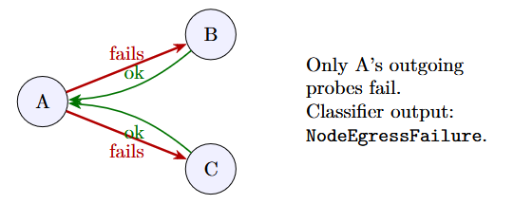
Analysis
The system evaluates the directed source-to-destination reachability matrix to identify the specific shape of network failures
The analysis package includes a hysteresis tracker, requiring repeated consecutive failures or successes before transitioning the health state, which successfully filters out short, transient network noise.
If an agent experiences a control-channel error or the failure pattern is ambiguous, the system outputs an Unknown classification.

Slide 10
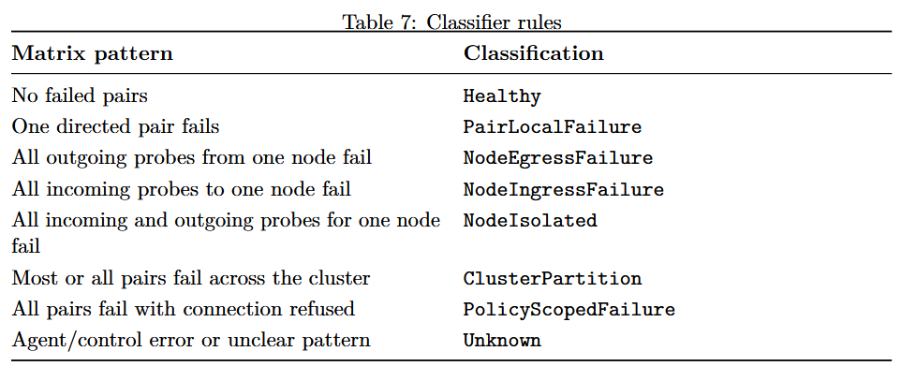
Fault Classification

Slide 11
Remediation
For the scope of prototype development we were conservative regarding Remediation – implementing 2 straightforward remediation protocols
Option 1: Alerting: For broad, cluster-wide issues like a ClusterPartition or a PolicyScopedFailure, the operator safely halts remediation and defaults to alerting via Prometheus metrics and updating the Kubernetes status.
Option 2: Targeted Pod Restarts: For localized, high-confidence failures (e.g., an isolated node or a degraded agent), the operator can execute a targeted restart of the specific matching agent pod.
The remediation protocol refuses to act if the verdict is Unknown.

Slide 12
Evaluation Scenarios
Scenario | Fault | Expected Classification
F1 | Healthy baseline | Healthy
F2 | Block inbound traffic on the target agent data port | NodeIngressFailure
F3 | Block outbound traffic from the target agent data port | NodeEgressFailure
F4 | Kill Calico node pod and isolate the agent data port | NodeIsolated
F5 | Add 40 percent packet loss with tc netem | Degraded or degraded evidence in metrics
F6 | Apply deny-all NetworkPolicy | ClusterPartition or PolicyScopedFailure, depending on observed error pattern

Slide 13
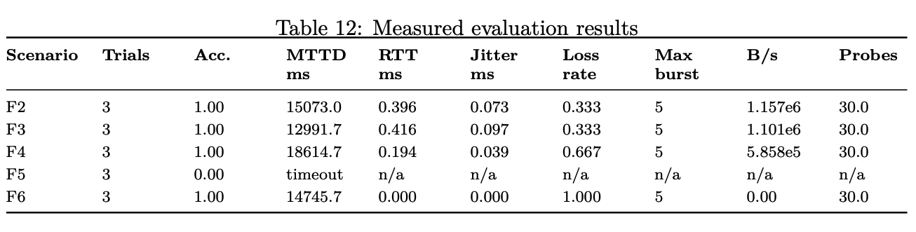
Results of Evaluations

Slide 14
Thank You

